Slide 1

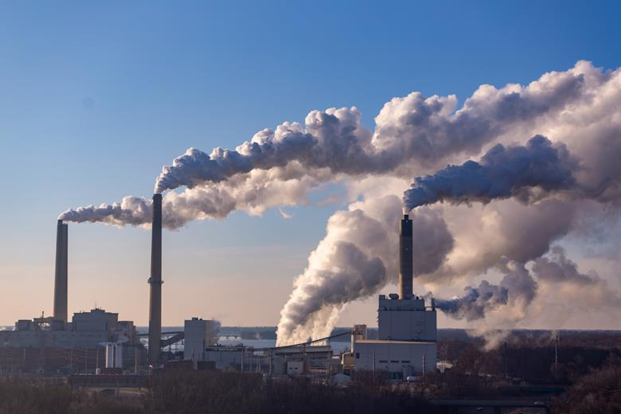
Presented by Isaac Owusu Akowuah
ENVIRONMENTAL IMPACTS OF FOOD
Trends and challenges

Slide 2

Presentation Outline
Project Title
Presentation outline
Business Questions
Key Insights
Recommendations

Slide 3

Business Questions
Which food products have the highest and lowest carbon emissions?
How do Plant-Based vs. Animal-Based foods compare in environmental impact?
Which food production stage contributes most to Emissions?
How do different food types impact the environment?
What are the top five contributors to Eutrophication?
Do we have cluster of group of foods based on their environmental impact?
What is the environmental impact by cluster?
What is the environmental impact by Category (Plant Based and Animal Based)
What are the Environmental factors across Category?

Slide 4
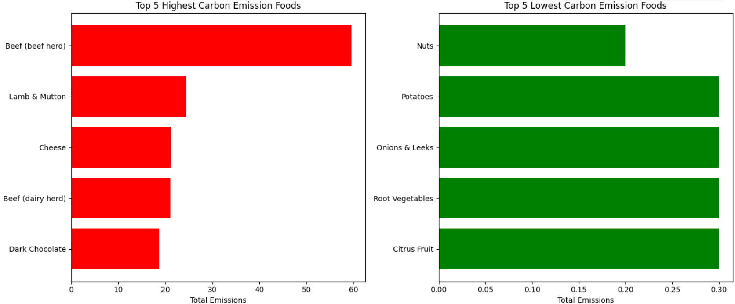
1. Five highest and lowest food products with the carbon emissions.
Beef is the most carbon-intensive food – Beef (beef herd) has the highest carbon footprint, emitting nearly 3x more than lamb & mutton and significantly more than all other foods on the list.
Plant-based foods are far more sustainable – The lowest-emission foods (nuts, potatoes, onions, root vegetables, citrus) emit less than 1% of the emissions from beef, highlighting the environmental benefit of plant-based diets.
Dairy and processed foods also have high impacts – Cheese and dark chocolate rank among the highest emitters, showing that not only meat but also dairy and luxury products contribute disproportionately to carbon emissions.

Slide 5

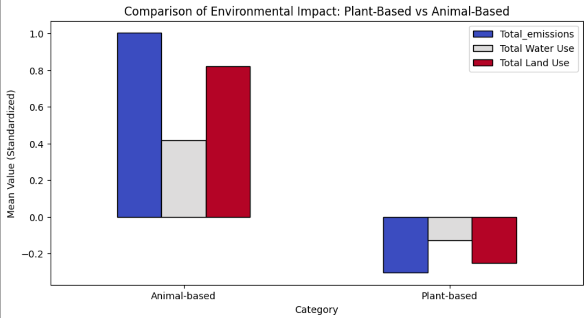

2. Plant-Based vs. Animal-Based foods compared in environmental impact
Animal-based foods have a significantly higher environmental impact across emissions, water use, and land use compared to plant-based foods.
Total emissions and land use are particularly high for animal-based foods, indicating they contribute more to environmental degradation.
Plant-based foods show a much lower impact, reinforcing the idea that shifting to a plant-based diet could reduce environmental strain.

Slide 6
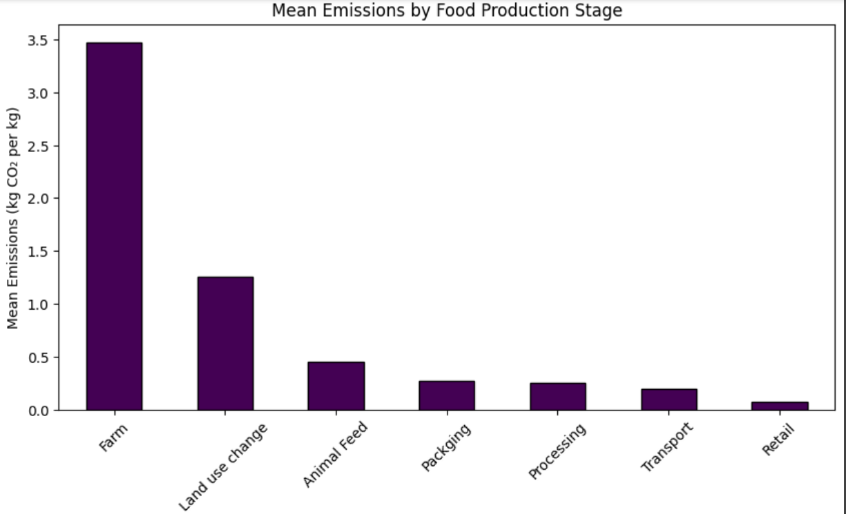
3. Food production stages that contribute most to Emissions
Farm is the top food production stage that releases emission to the environment.
Farm releases about 3.4 kg Co2 into the environment
Land use change also contributes about 1.4 kg Co2 into the environment.
Animal Feed is the third food processing stage releasing about 0.5 kg Co2 into the environment.
Packaging, Transport and Retail respectively releases emission 0.3, 0.2 and 0.1 kg Co2 into the environment.

Slide 7
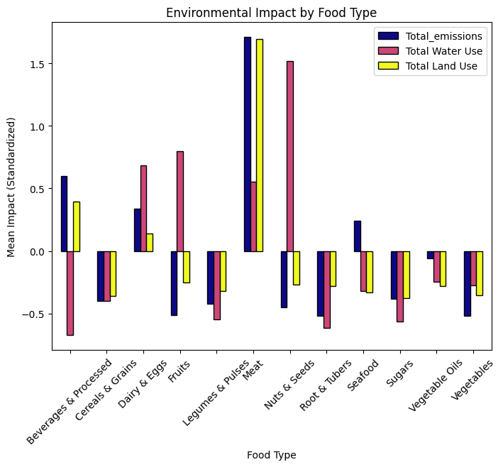
4. Different food types impact the environment?
Meat, nuts & seeds, and dairy & eggs have the highest environmental impact across all three categories (emissions, water use, and land use).
Legumes, vegetables, and cereals have lower environmental impacts, reinforcing their sustainability.
Water use is particularly high for nuts & seeds, likely due to irrigation requirements.
Beverages & processed foods show a negative impact for water use, suggesting they may have a lower overall water footprint.

Slide 8
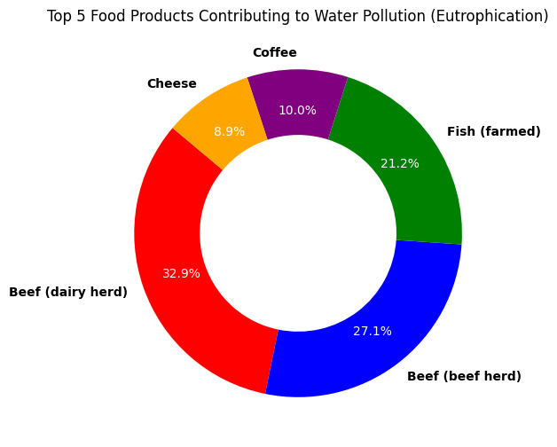
5. The top five food Products contributors to Eutrophication
Beef products dominate eutrophication impact: Beef (dairy herd) and Beef (beef herd) together account for over 60% of the top 5 contributors, showing that beef production has the highest water pollution footprint.
Animal-based products outweigh plant-based: Except for coffee, all the top contributors are animal-derived (beef, fish, cheese), highlighting the disproportionate environmental impact of livestock farming.
Dairy vs. Cheese trade-off: While cheese appears lower (≈9%), dairy herd beef has the single highest impact (≈33%), suggesting that reducing cattle-based food products could significantly lower eutrophication.

Slide 9

6. Cluster of Different food types impact the environment.
01.
The largest cluster, containing the majority of food items with low environmental impact.
02.
A small group of outliers with extremely high environmental impact, likely representing foods like beef and dairy.
03.
Intermediate-impact foods, possibly representing nuts, seeds, and certain fish products.

Slide 10
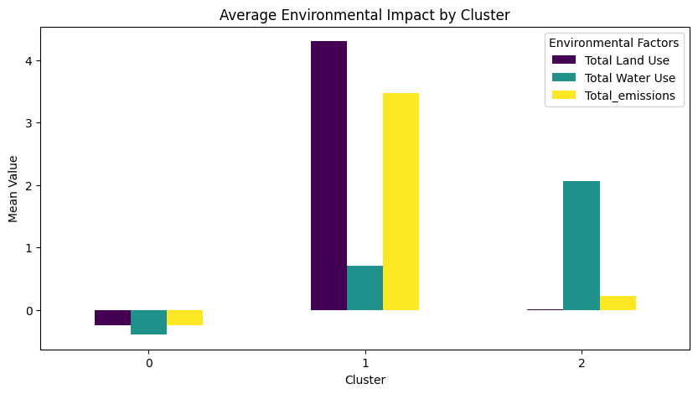
7. Environmental impact by cluster
Some clusters have high land use but moderate emissions, while others have high emissions but lower land use.
Certain clusters have significantly higher water use, indicating food types that are more water-intensive.
High land use & emissions clusters → Likely dominated by animal-based products.
High water use clusters → Could be plant-based foods like nuts or rice.

Slide 11
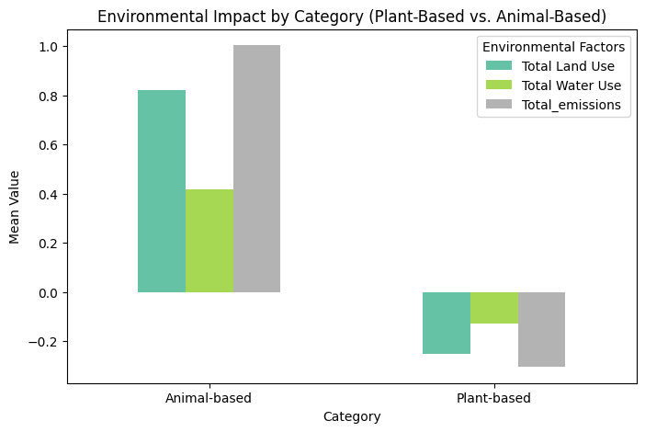
8. Environmental impact by Category (Plant Based and Animal Based)
Animal-Based products have much higher emissions and land use than Plant-Based products.
Water use is more balanced, with some Plant-Based foods; like nuts, rice using significant amounts.
This confirms that reducing animal-based foods can lower environmental impact, particularly in terms of emissions and land use.​

Slide 12
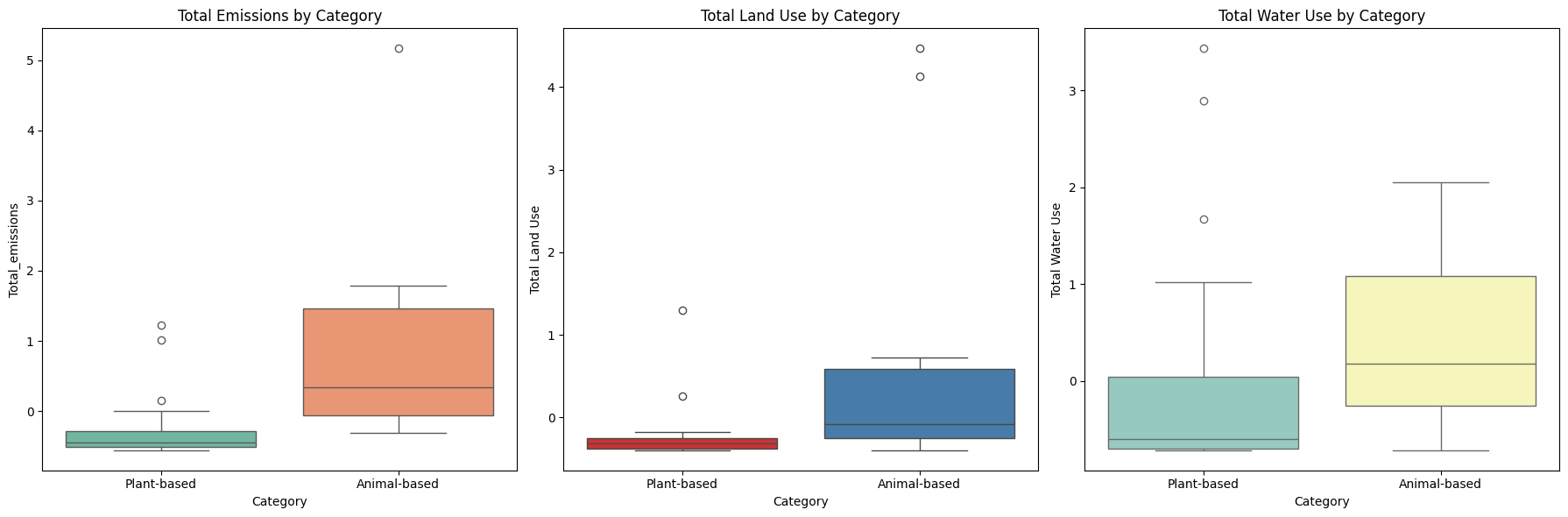
9. Environmental factors across Category
Emissions: Animal-based products generally have higher emissions than plant-based ones.
Land Use: Animal-based products tend to require significantly more land.
Water Use: There is a wider range of water use across both categories, but some animal-based products show extreme values.

Slide 13
Recommendations
04.
05.
Educate Consumers & Companies:
Run awareness campaigns to show the environmental footprint of different food types, helping consumers make informed choices.
Provide dashboards or tools for companies to track their food supply chain’s environmental impact in real-time.
Focus on High-impact Clusters:
Target interventions on high-emission and high-land-use clusters (e.g., beef, lamb, dairy) for maximum environmental benefit.
Promote resource-efficient foods like legumes and root vegetables that deliver nutrition with minimal footprint.

Slide 14
Recommendations
01.
02.
03.
Support Sustainable Agriculture Practices:
Work with farmers to optimize farm emissions, since the farm stage contributes most to emissions.
Encourage adoption of low-emission feeds, regenerative farming, and efficient land-use practices.
Invest in precision agriculture to reduce fertilizer and water overuse.
Encourage Eco-friendly Food Systems:
Support companies in adopting sustainable packaging and transport methods to cut down secondary emissions.
Develop policies or incentives that reward low-impact food production (e.g., plant-based or sustainable aquaculture).
Promote Sustainable Diet Shifts:
Encourage clients and stakeholders to reduce beef and dairy consumption, as these are the highest contributors to carbon emissions and eutrophication.
Promote plant-based alternatives (legumes, vegetables, cereals) as they have significantly lower environmental impacts.

Slide 15

Presented by Isaac Owusu Akowuah
Thank you very much!

